Slide 1

Cool T-Shirts
Learn SQL from Scratch- First- and Last- Touch Attribution
Brandy Solomon
07/24/2018

Slide 2
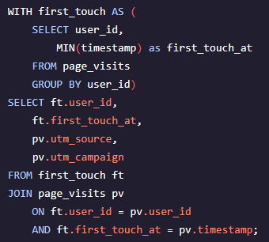
Table of Contents
First-touch query
Get familiar with Cool T-Shirts
What is the user journey?
Optimize the campaign budget

Slide 3
1. Get Familiar with Cool T-Shirts

Slide 4
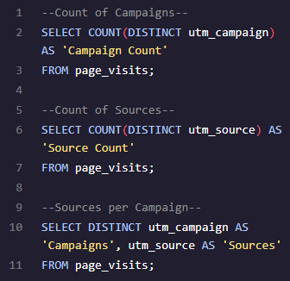
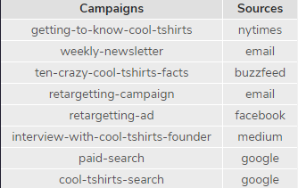
1.1 Get Familiar with Cool T-Shirts
How many campaigns and sources does Cool T-Shirts use?
Total campaigns: 8
Total sources: 6
Which source is used for each campaign?
See chart below

Slide 5
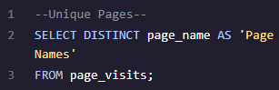
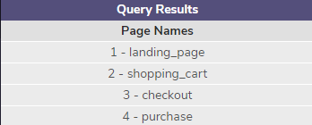
1.2 Get Familiar with Cool T-Shirts
What pages are on the Cool T-Shirts website?
See List Below

Slide 6
2. What is the User Journey?

Slide 7
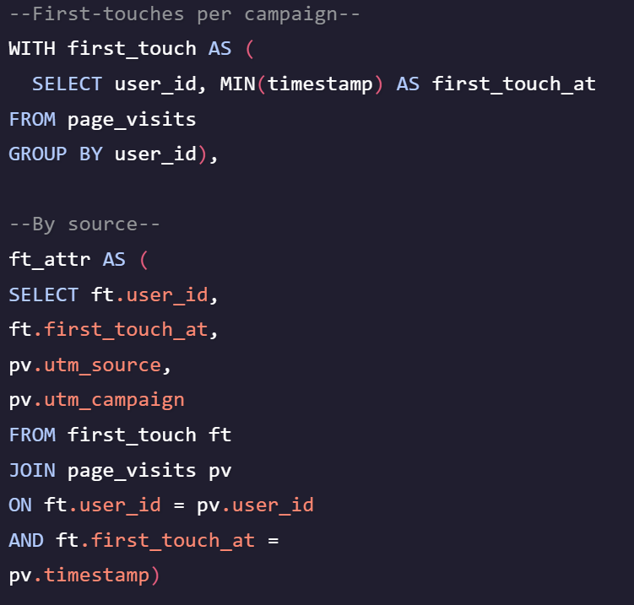
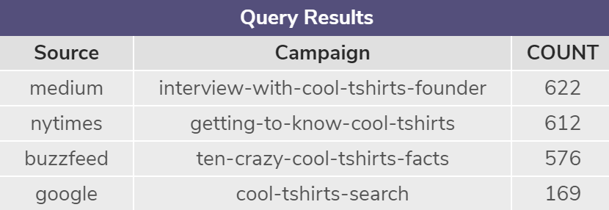
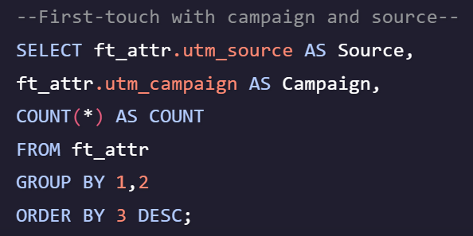
2.1 What is the User Journey
How many first touches is each campaign responsible for?
See table below:

Slide 8
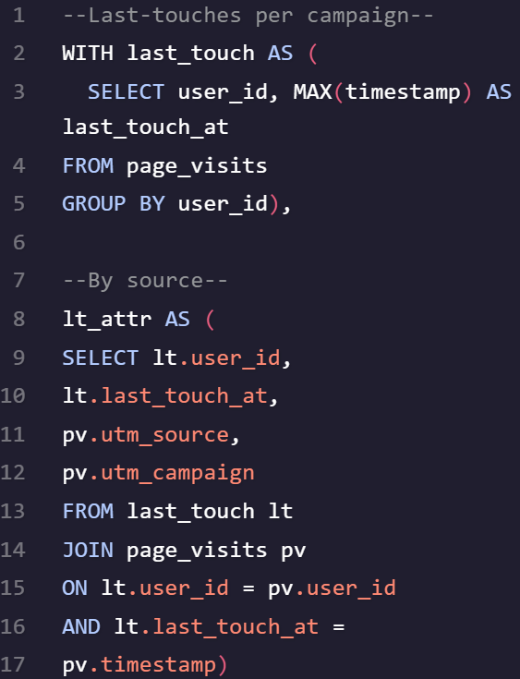
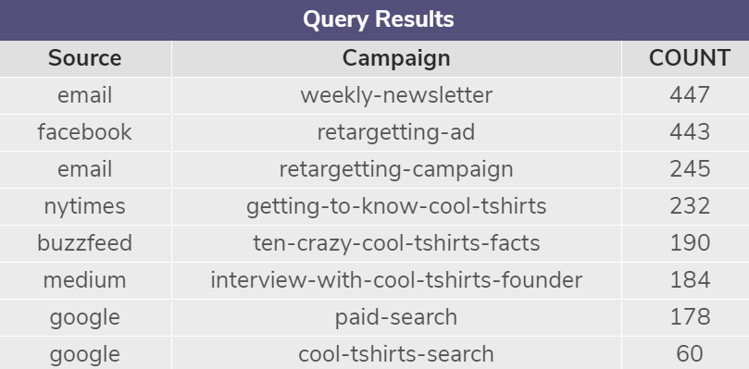
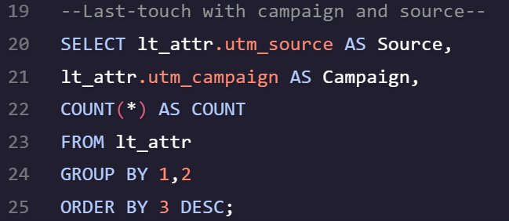
2.2 What is the User Journey
How many last touches is each campaign responsible for?
See table below:

Slide 9
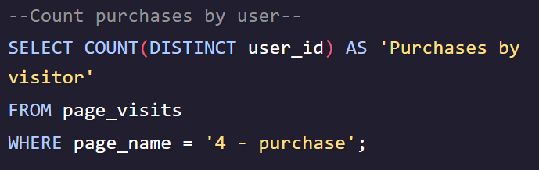
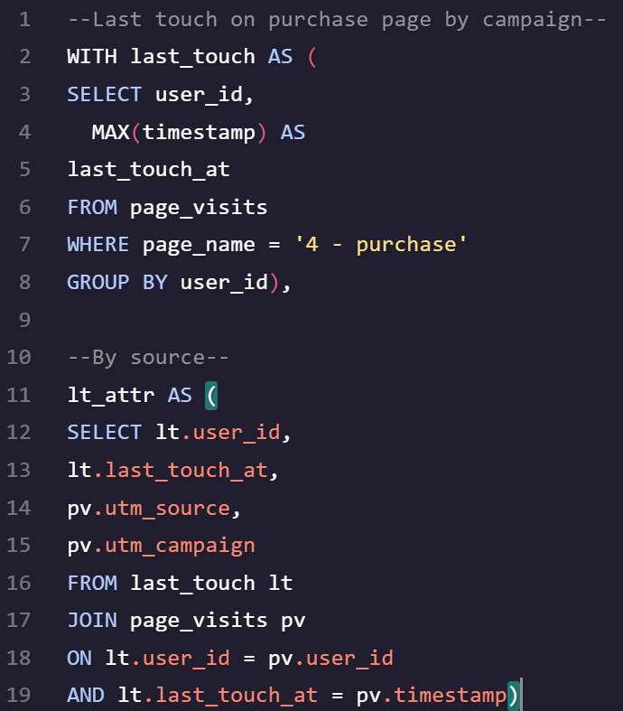

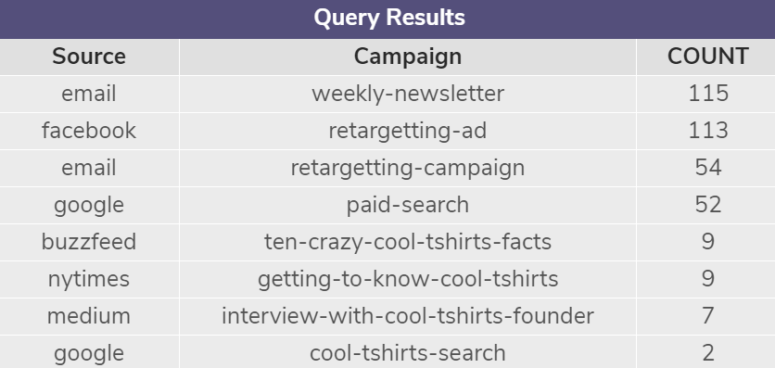
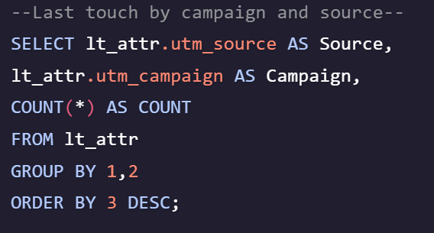
2.3 What is the User Journey
How many visitors make a purchase?
How many last touches on the purchase page is each campaign responsible for?

Slide 10
3. Optimize the Campaign Budget

Slide 11
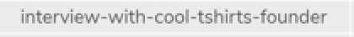
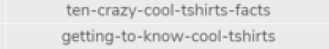
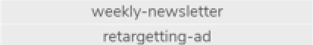
3.1 Optimize the Campaign Budget
Which 5 campaigns should Cool T-Shirts re-invest in?

